Slide 1


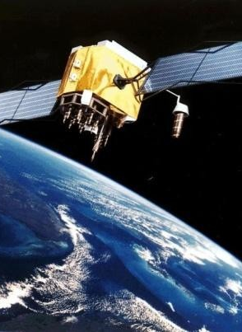


Satellite Navigation using GNSS

Slide 2
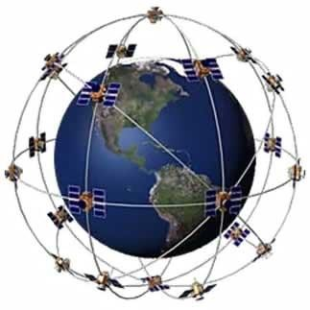
Outline
Basics of Satellite Navigation
GNSS Systems
GPS System, Measurements, Performance
Augmentation Systems
Differential GPS (DGPS)
Space Based Augmentation Systems (SBAS)
Ground Based Augmentation Systems (GBAS)
Practical Applications
Scientific Exploration
Ionospheric Studies
Space Weather
Summary

Slide 3
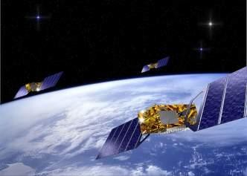
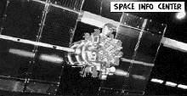

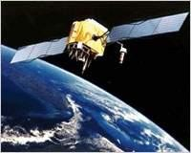
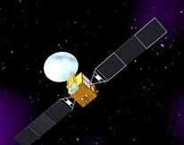
GNSS Systems
Compatible and Interoperable
GLONASS
Galileo (EU)
Beidou/COMPASS (China)
Global Positioning System (GPS)

Slide 4
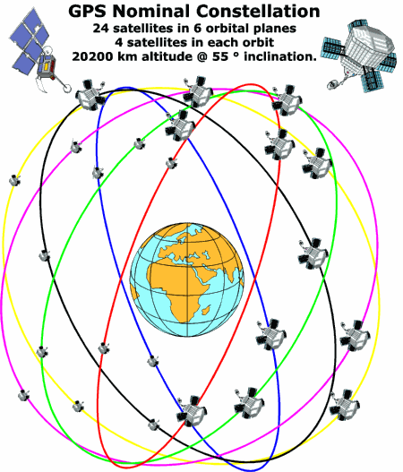
The Global Positioning System (GPS)
Worldwide Radio-Navigation System
Developed and maintained by U.S. DoD
Original intended use was military
Early-on civilian use was enabled
Provide 3D Positioning, Velocity and Time
24hrs/day,7 days/wk, everywhere!
GPS Consists of Three Segments
Space Segment
Control Segment
User Segment
Based on Satellite Ranging
Users determine position by measuring the
GPS Space Segment
distance from a group of satellites in space

Slide 5
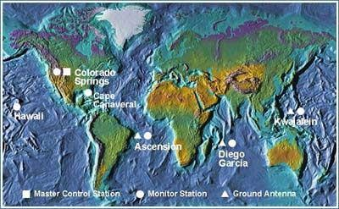
The Global Positioning System (GPS)
Worldwide Radio-Navigation System
Developed and maintained by U.S. DoD
User Segment:
Original intended use was military
Early-on civilian use was enabled
Provide 3D Positioning, Velocity and Time
24hrs/day,7 days/wk, everywhere!
GPS Consists of Three Segments
Space Segment
Control Segment
User Segment
Based on Satellite Ranging
Users determine position by measuring the distance from a group of satellites in space
You and 200 Million other people
GPS Control Segment

Slide 6

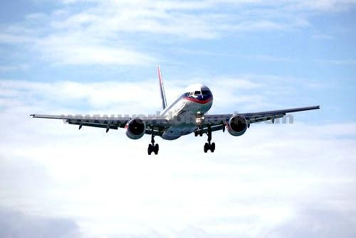
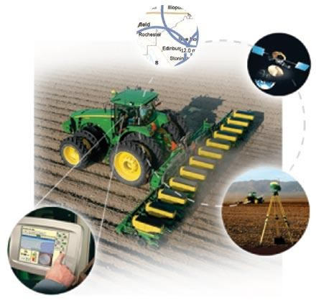

The Global Positioning System (GPS)
Worldwide Radio-Navigation System
Developed and maintained by U.S. DoD
Original intended use was military
Early-on civilian use was enabled
Provide 3D Positioning, Velocity and Time
24hrs/day,7 days/wk, everywhere!
GPS Consists of Three Segments
Space Segment
Control Segment
User Segment
Based on Satellite Ranging
Users determine position by measuring the distance from a group of satellites in space
6 Monitor Stations
1 Master Control Station 3 Ground Antennas

Slide 7
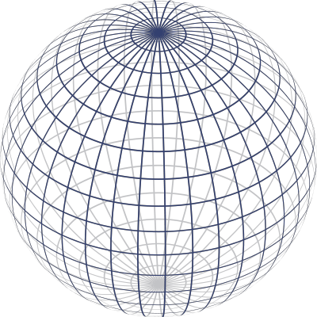


















How does it work?
Trilateration by Satellite
First measurement puts us somewhere on
this sphere.
Measurement from a second satellite shows we are somewhere on this circle where the first and
second spheres interrsect
Third measurement from another satellite places us at one of two points.
A fourth measurement will give us time!

Slide 8
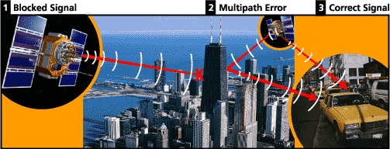
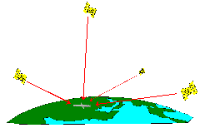
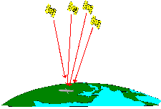
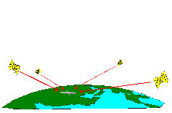
Sources of GPS Errors
Receiver clock errors
Good DOP
Poor HDOP
Poor VDOP
Signal multipath
Orbital errors
Number of satellites visible
Satellite geometry
Tropospheric and Ionospheric delays
(www.garmin.com)
Typical Standard Positioning Service (SPS) GPS position accuracy:
~10-15 meters (mostly due to the ionosphere)

Slide 9
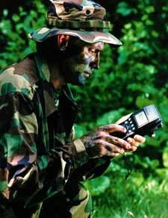
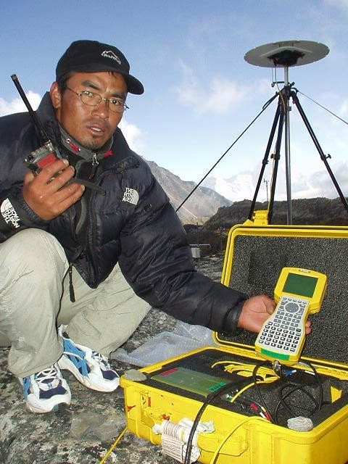
Two Levels of GPS Service
Precise Positioning Service (PPS)
Authorized users ONLY
U. S. and Allied military
Requires cryptographic equipment, specially equipped receivers
Accurate to 21 meters 95% of time
Standard Positioning Service (SPS)
Available to all users
Accuracy degraded by Selective Availability until May 2000
Horizontal accuracies ~100 m
Current accuracy similar to PPS (≤15m)
Less for Augmented GPS: DGPS,SBAS,GBAS

Slide 10
GPS Augmentations
Why augment?
For better accuracy: Mitigate measurement errors
For robustness: Mitigate effects of
RFI (intentional or not)
Signal attenuation due to blockage (foliage, building, or temporary loss of signal
How augment?
Transmit corrections for errors that are correlated spatially and temporally
Differential GPS
Wide Area Differential GPS
Space Based Augmentation Systems (SBAS)
Local Area Augmentation Systems (GBAS)
Assist GPS receiver with complementary technologies (e.g. intertial), signals of opportunity (eLoran), or offloading some functions (to a cell tower in E911)
Based on P. Misra, 2009

Slide 11
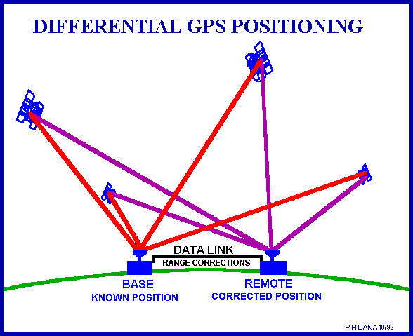
Differential GPS (DGPS)
Uses 2 receivers
Reference receiver
Remote/roving receiver
Reference receiver calculates the errors in the received GPS signals
Transmits corrections to rover receiver
via radio link or mobile phone
Public and private reference beacon stations are available
US Nationwide NDGPS
US Maritime MDGPS
40 other countries have similar systems
DGPS Accuracy: ~1–3 m Degrades with distance

Slide 12

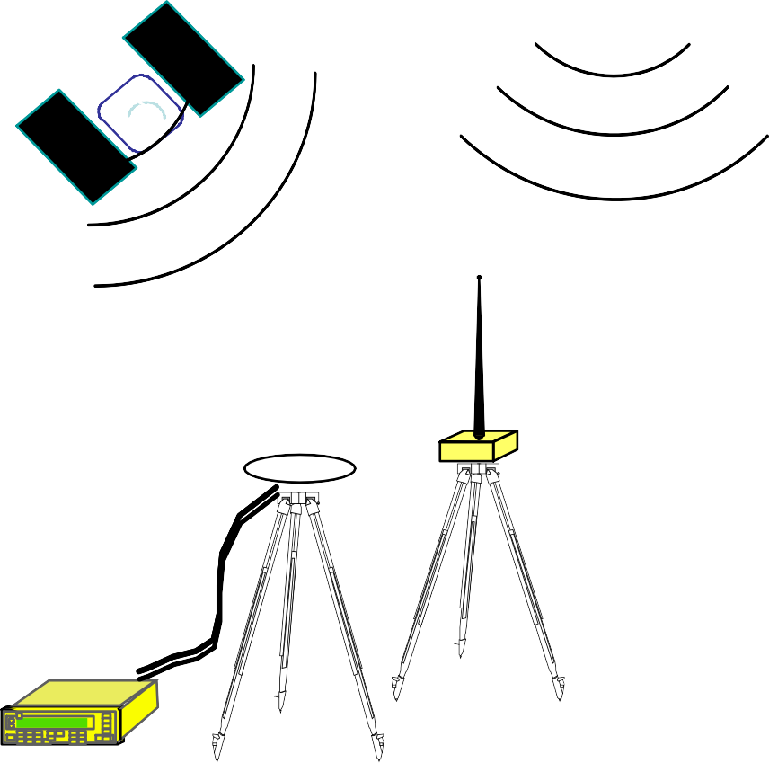

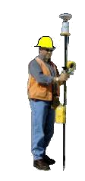






Real Time Kinematic
ROVER
BASE STATION OVER KNOWN POINT
Centimeter Accuracy
10
Figure from Dorota Brzezinska

Slide 13
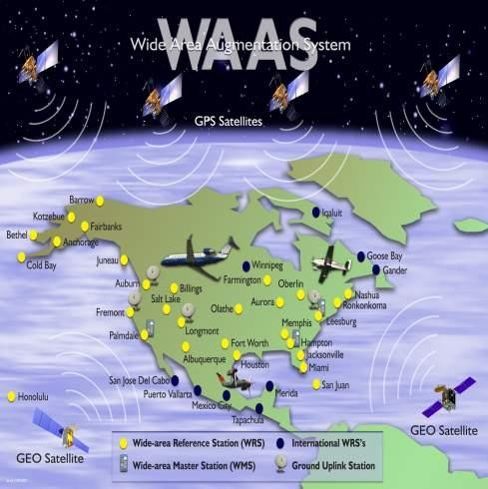
Satellite Based Augmentation Systems (SBAS)
Designed to improve GPS accuracy, availability and integrity for civil aviation.
Current Infrastructure:
38 Reference Stations
3 Master Stations
4 Uplink stations
2 Communications Satellites
WAAS message provides:
corrections for satellite orbits,
time and the ionosphere
estimates of the uncertainty of
Courtesy of the FAA
Future primary means of civil air navigation
those corrections
For all aircraft in all phases of flight
Non-Precision Approach (NPA) – en-route
WAAS Accuracy: ~1–3 m
Vertically Guided Approach (LPV) – runway
First of many worldwide systems – EGNOS, MSAS, GAGAN

Slide 14
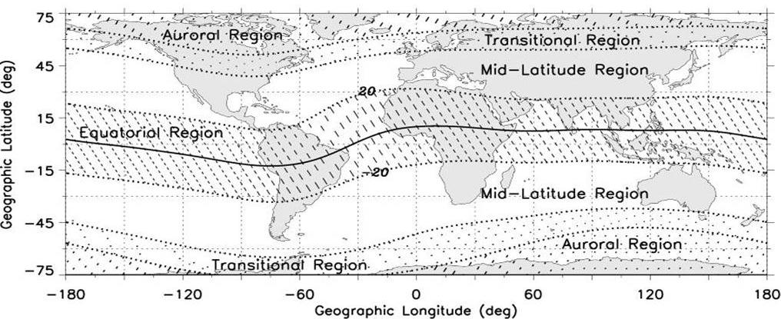
Satellite Based Augmentation Systems (SBAS)
(ICAO is committed to transition to satellite navigation)
WAAS operational in 2003
CWAAS
EGNOS – The European Satellite Augmentation System – 2009
MSAS – The Asia Pacific Satellite Augmentation System – 2007
EGNOS
SNAS
MSAS
WAAS
GAGAN
CSTB
CSTB – South American Satellite Augmentation System - TBD
GAGAN – Indian Satellite Augmentation System – TBD
SNAS – Chinese Satellite Navigation Augmentation System - TBD
Systems in equatorial regions will face more
challenging ionospheric dynamics.

Slide 15
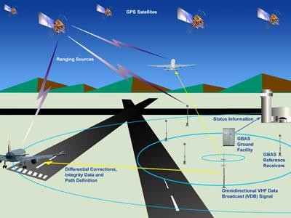
Ground Based Augmentation System (GBAS)
LAAS
Local Area Augmentation System
Provides local airport coverage:
~20-30 mile radius
4 Receivers; 1 VHF radio data link from a ground-based transmitter
Precision Approach for CAT- I, II, III
Procedures for Arrival and Departure
Multiple runway coverage at an airport terminal area
Demonstrated accuracy is < 1 meter

Slide 16
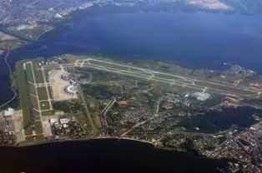
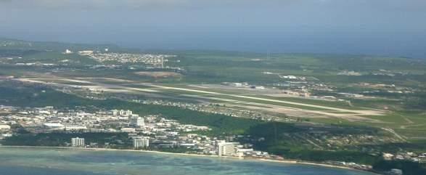
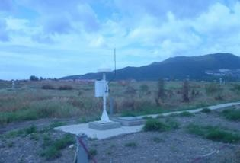
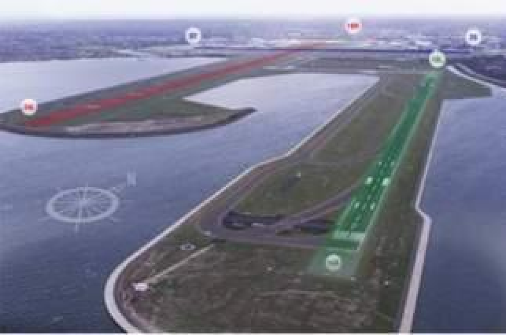
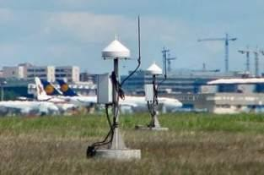

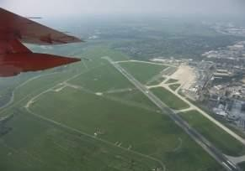
LAAS/GBAS International Efforts
Rio De Janeiro, Brazil
Agana, Guam
Malaga, Spain
Sydney, Australia
en
n.
Frankfurt, Germany
Bremen, Germany

Slide 17
Typical GPS Ranging Errors
Error Source | SPS GPS | Differential GPS | RTK
User Range Errors
System Errors Ephemeris Data Satellite Clocks | 0.4 -0.5 m 1-1.2m | Removed Removed | Removed Removed
Atmospheric Errors Ionosphere Troposphere | 0.5 – 5m 0.2 -0.7m | 0.2 – 2.0m Removed | 0.0005 - .01m Removed
Total Typical URE Errors | 1.7 – 7.0m | 0.2 – 2.0m | 0.0005-0.01m
User Equipment Errors
Receiver | 0.1 – 3m | 0.1 – 3m | Almost All Removed
Multipath | 0-10m | 0-10m | Greatly Reduced

Slide 18



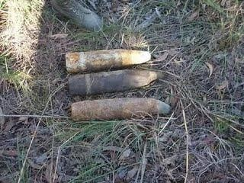
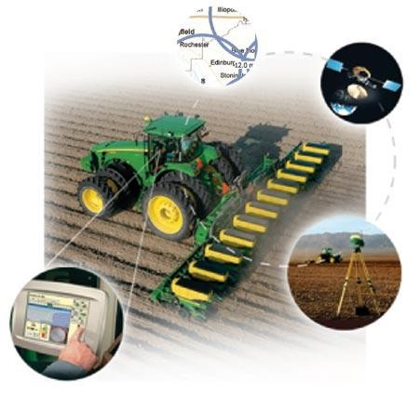
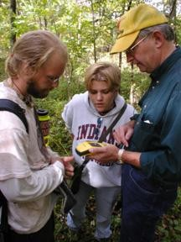
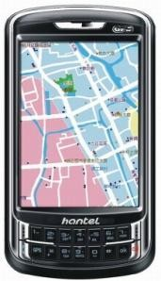
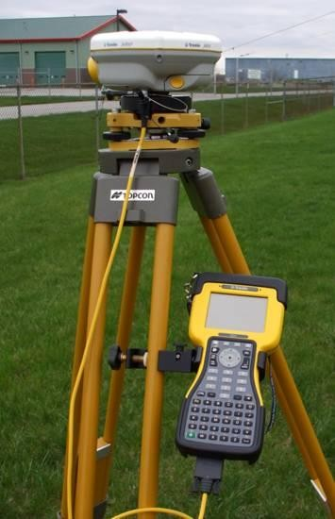


Applications
Annual Commerce in GPS Products and Services > $10billion
>200 Million Users

Slide 19
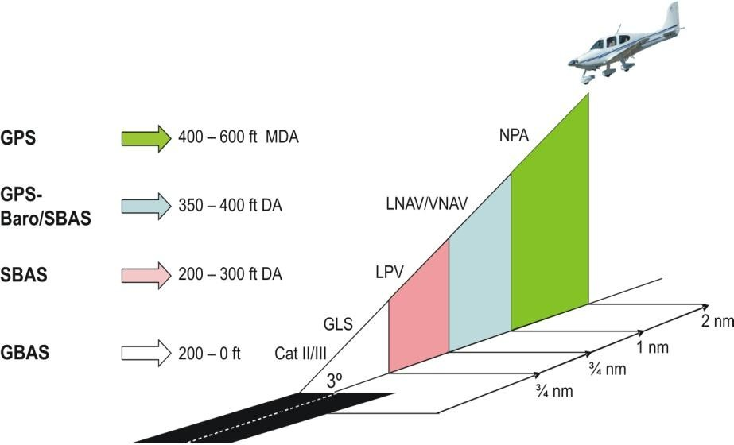
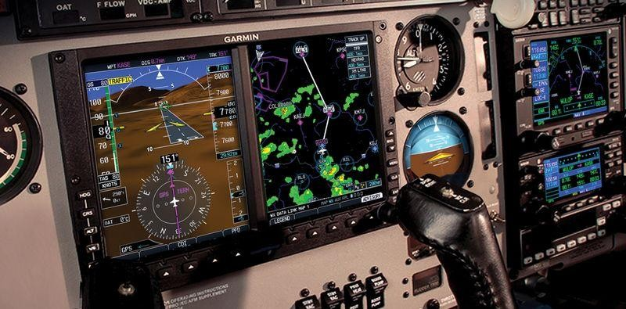
Precision Approach & Landing (SBAS&GBAS)
Improves the accuracy, integrity and availability of GNSS
Efficiency
More direct en-route paths
Greater runway availability
Precision Approach for all users
Cost
Low cost avionics
Reduction of ground based navigation
aides
Safety
Vertical Guidance for all phases of flight
takeoff, en-route to precision approach
Available at all runway poor visibility
Situational Awareness
FAA
GARMIN Aircraft Receiver

Slide 20
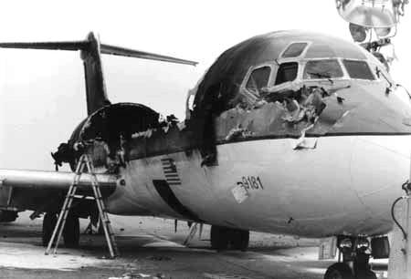
Detroit, Mich., 3 Dec. 1990
Northwest Airlines DC-9
DC9, lost in fog, blunders onto an active runway and is struck by departing 727. 8 dead, 22 injured

Slide 21
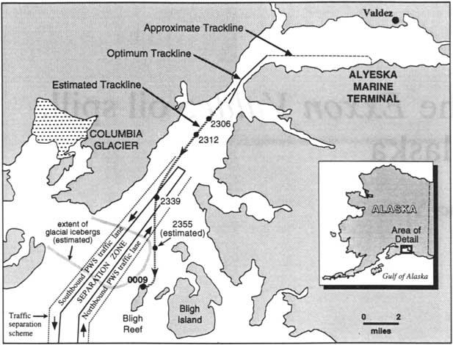
Exxon Valdez, March 24, 1989
Ran Aground on Bligh’s Reef
2008, Institute of Navigation, Per Enge

Slide 22
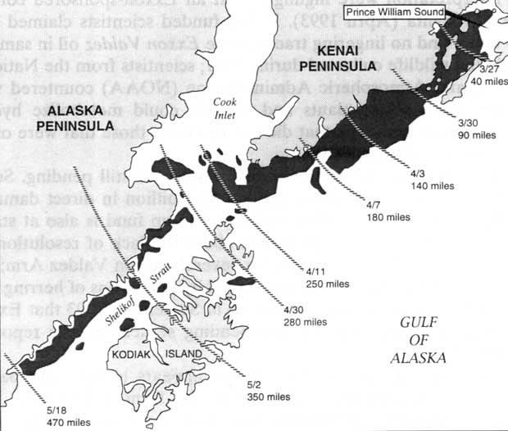
Exxon Valdez (continued)
10.8 Million Gallons of Oil Spilled
2008, Institute of Navigation, Per Enge

Slide 23
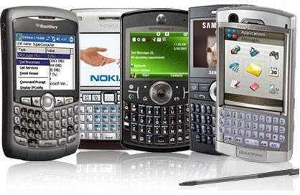
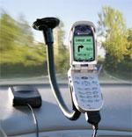
Smart Phones
Smart Phones (cell phone + PDA)
GPS used for emergency calls
Emergency location
Applications include:
Basic maps
Turn by turn directions
$200 – $400
Cell Phones with GPS embedded
Mostly for E911 calls only

Slide 24
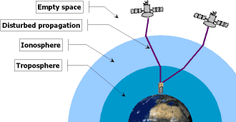
Scientific Exploration with GNSS
Seismic monitoring & prediction
Volcano monitoring
Climate change
Gravity fields
Atmospheric science
ground water vapor
the ionosphere
space weather

Slide 25
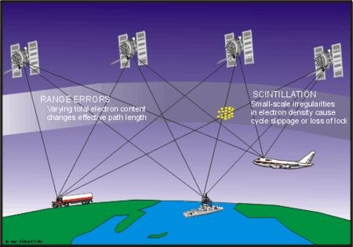
Ionospheric Effects on GPS
TEC
Induces Range Errors
Highly variable with location, time, season, magnetic and solar activity
Scintillation
Induces rapid changes in amplitude and phase of incoming signal
Can induce cycle slips and loss of lock that degrade performance

Slide 26
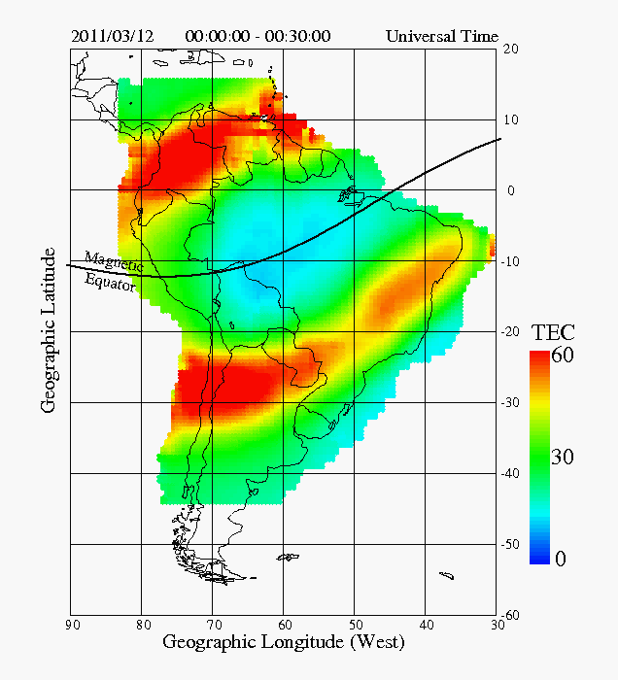
The LISN Network using >75 GPS Receivers

Slide 27

GNSS for Scientific Research in Africa
Africa has a most challenging
ionosphere :
Strong latitudinal gradients
Within northern and southern anomaly peaks
Covers a wide longitudinal region
Depletions and scintillation are potentially the worst conditions worldwide
The Worldwide Ionosphere

Slide 28
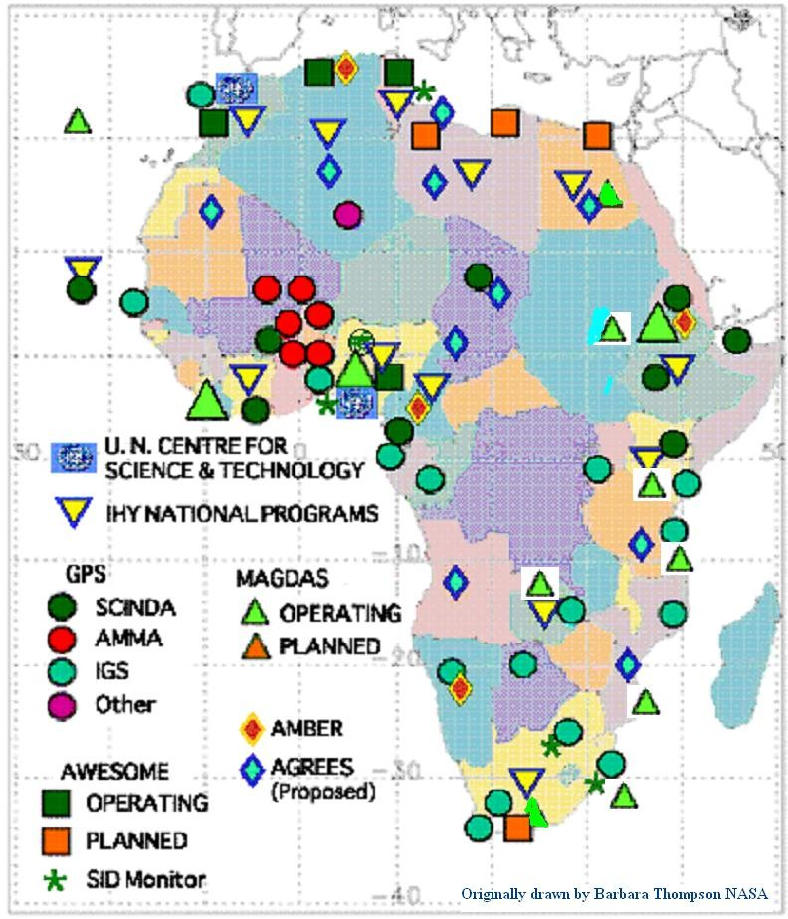
Ionospheric Monitors in Africa
13 units of MAGDAS
7 units of GPS including SCINDA,
4 units of AWESOME
20 units of SID monitors
data obtained from these facilities are being used to improve our understanding of space weather as it affects the performance of GNSS
Additional monitors:
3 units GPS from BC –
More planned under ICTP/BC partnership
Ionosondes planned
Based on presentation by Dr. Rabiu Babatunde

Slide 29
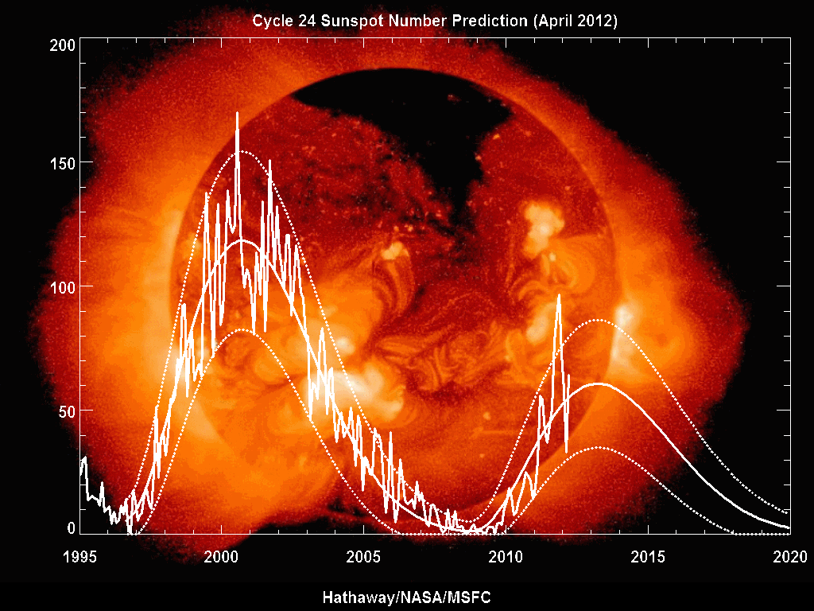
Solar Cycle Dependence
all effects intensify with increasing solar activity

Slide 30
Simple Summary
GNSS is an enabling technology that can make major contributions to economic growth and societal betterment. It is also a key to scientific exploration.

Slide 31


Thanks !

